Slide 1
Sector Based Trade Recommendation System
Presented By:
Rujuta Palimkar
Vidisha Pandey
Shilpa Jagtap
Mandira Samjiskar
Gargi Kulkarni

Slide 2
AGENDA
Section 1 : • Problem Statement
• Introduction
• Project Overview
Section 2 : • System working
• Databases
• Business Logic
• User Interface
Section 3 : • Conclusion
• Project Demonstration
• Q & A

Slide 3
PROBLEM STATEMENT
Sector based Trade Recommendation System
Construct a trade recommendation system based on user-selected sectors (from Nifty stocks)

Slide 4
INTRODUCTION
WHAT IS “TRADING RANGE”?
A trading range is the spread between the high and low prices traded during a period of time.
When a stock breaks through or falls below its trading range after several days of trading in a range, it usually means there is momentum (positive or negative) building.

Slide 5
PROJECT OVERVIEW
Technologies Used :
• Programming Language: Java , HTML, CSS, AngularJS
• IDE: Spring Tool Suite
• Database: MongoDB
• Web Service: Yahoo Finance API
• Server : Apache Tomcat Server

Slide 6
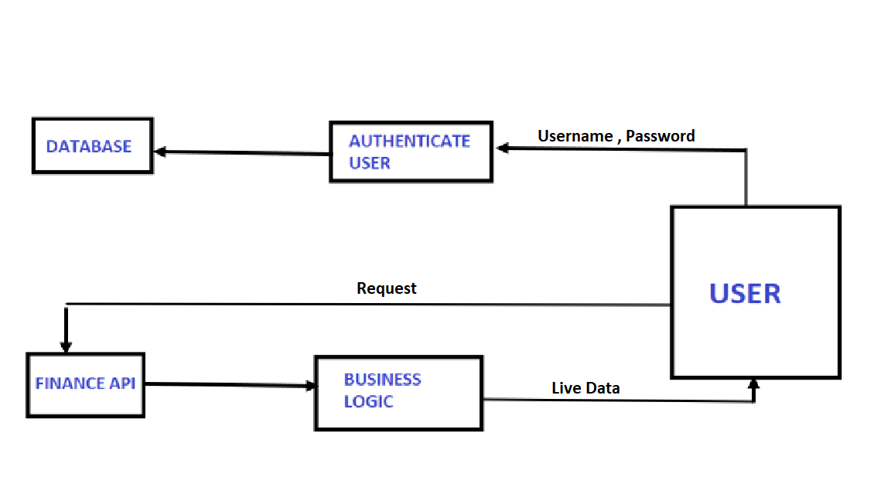
SYSTEM ARCHITECTURE

Slide 7
SCOPE OF THE PROJECT
The Sector Based Recommendation System allows the registered user to view the value of the stock prices at Nifty of the selected sector at the given instance of time.
The user is allowed to view the top recommendations, accumulated over the two weeks’ data that provide the best trading opportunities.
User is able select to save any of the recommended stocks with quantity and current market price.

Slide 8

BUSINESS LOGIC
Trade recommendation system takes live market data for specific sector based companies from Yahoo Finance API.
The fetched data is run under the expression
$\frac{High \left(today\right)−High (2 weeks ago)}{High (2 weeks ago)}×100$
to get the percentage of gain over the time duration.
The data is hence sorted in descending order to get the top five performing stocks.

Slide 9
BACKEND AND UI
BACKEND
Created on Spring Tool Suite(STS) using object oriented Java Programming language
Use of DAO , Dependencies and Annotations in STS.
Design Patterns/Techniques Used: RESTful web services
USER INTERFACE
Use of HTML + CSS + AngularJS Features of AngularJS
Angular’s components based approach is easy to follow.

Slide 10
RESTFUL WEB SERVICE
Features:
• Any interface between systems using HTTP to obtain data and generate operations on those data in all possible formats
• The most logical, efficient and widespread standard in the creation of APIs for Internet services.
• The four very important data transactions in any REST system and HTTP specification: POST (create),GET(read and consult),PUT (edit) and DELETE.

Slide 11
CHALLENGES
Finding appropriate API for the live data.
Understanding the working of different components and their interactions in Angular.
Understanding services and dependency injection.
Integrating frontend and backend

Slide 12
Project Demonstration

Slide 13
Thank You!!

